Slide 1
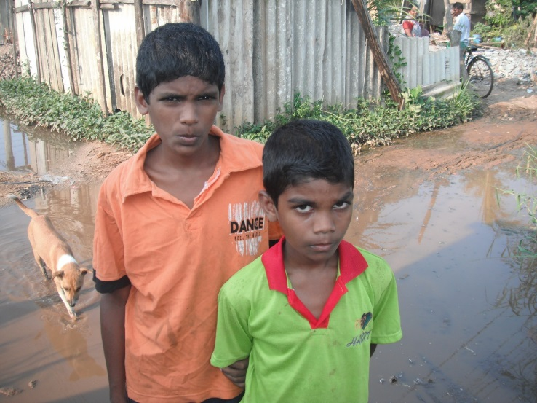
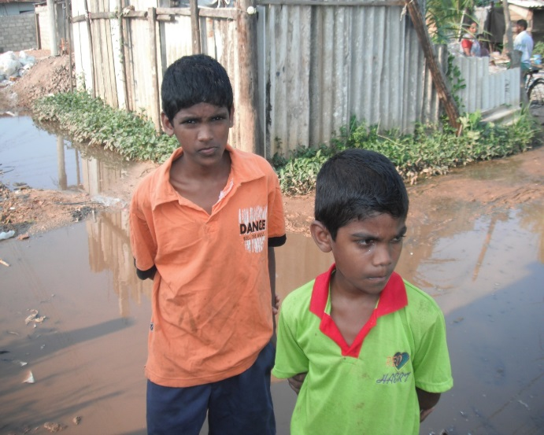
BE00021 Arun
Arun (right) is 9 years old and lives in Kerawalapitiya, Hendala.
He goes to Vidyaloka Maha Vidyalaya and is in grade 4. His studies are weak. He has 4 siblings but the oldest one lives in Colombo. His mother Arsia works as a housemaid about 4 days a week. This is temporary. His father is quite unwell and has a major gastritis problem and hardly goes to work because of this. His medication costs ad Rs300.
Their house was flooded at the time of the charity visit and they were unable to go right up to the house. It is apparently flooded up to 2 ½ feet. They live in the school when it is really bad.
They struggle to buy food when there is no income. They need food and clothes.
The charity has been helping them for nearly a year now. They have been using the grants to make ends meet and buy food for the children.
March 2013

Slide 2
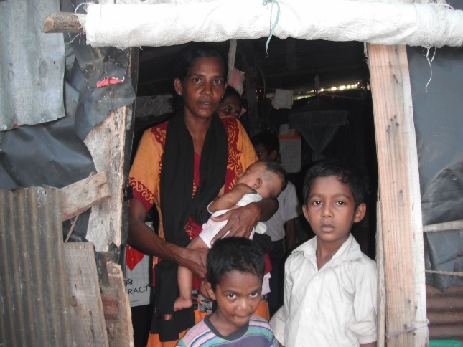
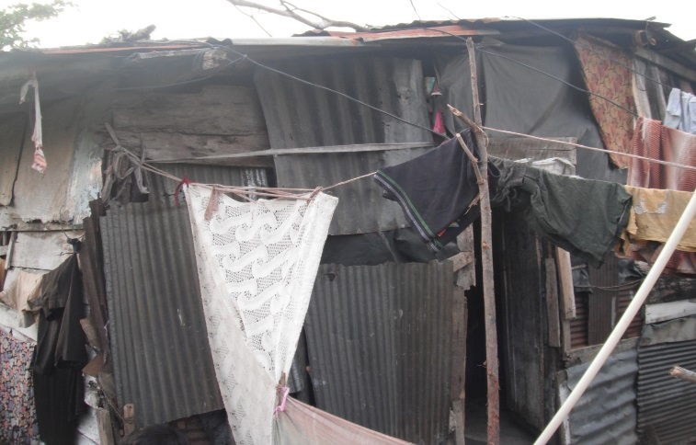
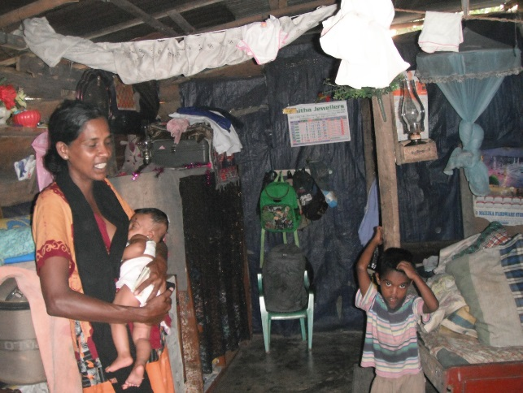
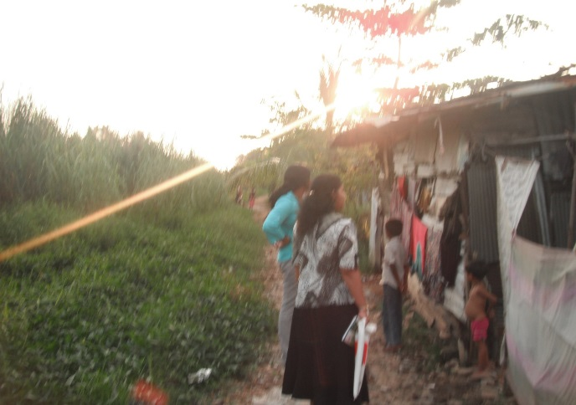
BE00022 Mohammed
Mohammed (right) is 14 years old and lives in Galagahaduwa Hendala. He goes to Vidyaloka Maha Vidyalaya and is in grade 8. His studies are average.
His mother Siththi works as a labourer. His father met with an accident and is unable to work. He has some medicines given b the hospital and has difficulty in buying the rest from the pharmacy.
They live in a temporary house and this is in a very poor state.
They have difficulty buying food and necessities when there is no income from the mother.
Mohammed has been getting help from the charity for nearly a year now and they have been using it to meet their daily needs. The clothes that were shipped out had also helped them.
March 2013

Slide 3
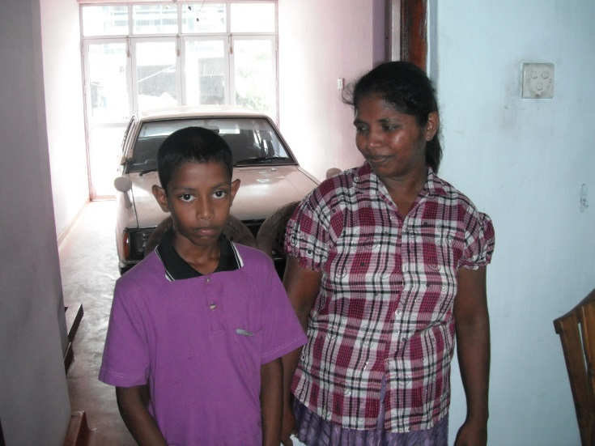
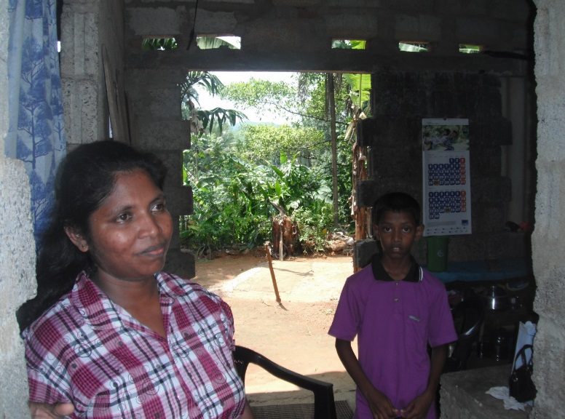
BE00023 Lahiru
Lahiru is 12 years old and lives in Agalawatta. He goes to Minhindu College and is now in grade 7. His studies are average and he achieved scholarship marks of 131/200.
Lahiru’s father passed away in March 2012 after he was bitten by a snake near his house. The charity started helping them from April. His father used to be a bus conductor.
He has a sister who is five years old. Her mother Udayangani works in rubber plantations when the weather is right for rubber tapping and earns about Rs400 a day. Ince the father’s death there is no permanent income for the family. Their house was also partially built when he passed away. It is just a small block with no doors. Lahiru came to see us at the representative’s house first and took us to see their house.
They have some relatives around who also help them out. There were hardly any possessions in the house. They looked extremely poor.
With the charity grants, Lahiru is able to take extra tuition classes for Science, English and Maths. These classes are helping him to do better. They have also used the money for their daily house expenses.
March 2013

Slide 4
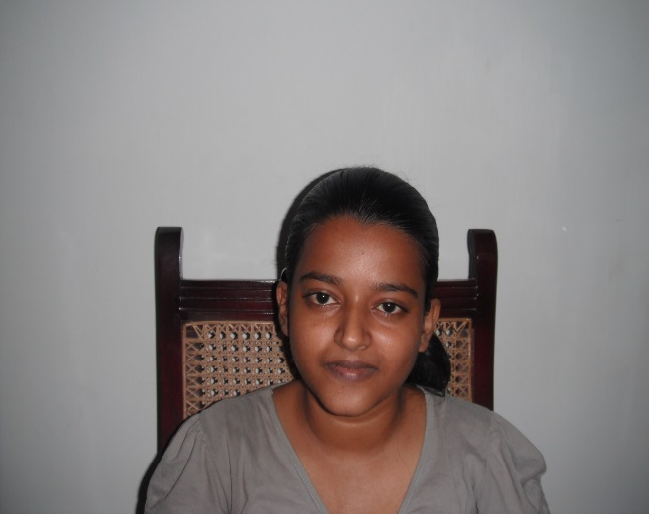
BE00025 Sachini Dilshiya
Sachini is 23 years old and lives in Wadduwa. She attended Sri Sumangala Balika maha Vidyalaya and is now studying for her undergraduate degree in the University of Jayawardanapura. He is in her second year starting in March 2013. She is an outstanding student recommended to us by teachers. She is very good with her studies and dancing, acting and sports. She has an older sister who also just finished her degree at the same university.
Their father Kumarasiri is unwell with a brain cancer. He was the sole breadwinner and he is now unable to work. There is no proper income for the family now. Her mother Dayasili used to work as a labourer but is now unable to work as she is at home looking after the father.
They are really struggling as the expenses are high with father’s illness. He is still continuing with the treatments at Maharagama Hospital and needs regular blood check ups that cost them about Rs600 a week. He also needs a taxi to travel to the hospital as he has a heart condition. He had a heart operation in 2010 and got really unwell in 2012. Sachini needs to buy a bus pass to go to the university which costs about Rs1000 monthly. The taxi to the hospital also costs about Rs1000. Sometimes the father’s friends also help out with their expenses. The sister recently found a job at Arpico Finance dept. She is helping out the family now but the expenses are still difficult to cover. The grants they are getting from the charity has been a great relief for them. She has been using it for her travel expenses, books and also fruits and milk for her father. We were unable to visit her at the house but she came to see us at the representative’s house in Wadduwa to discuss her progress.
March 2013

Slide 5
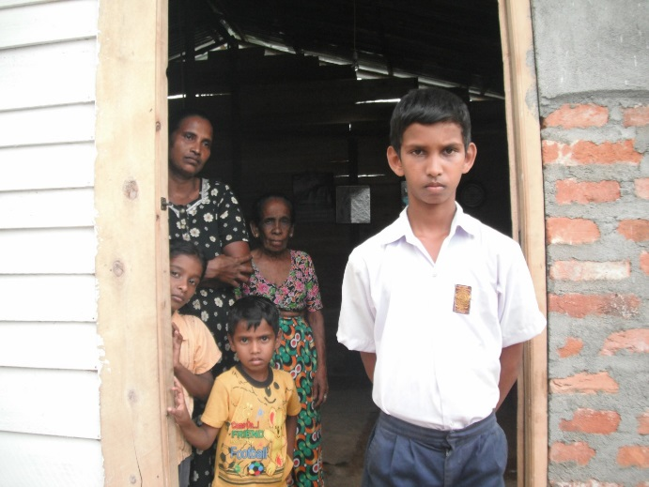
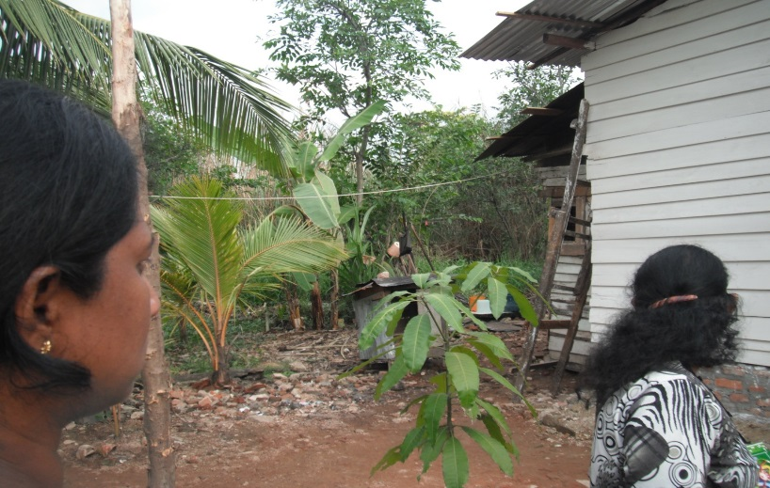
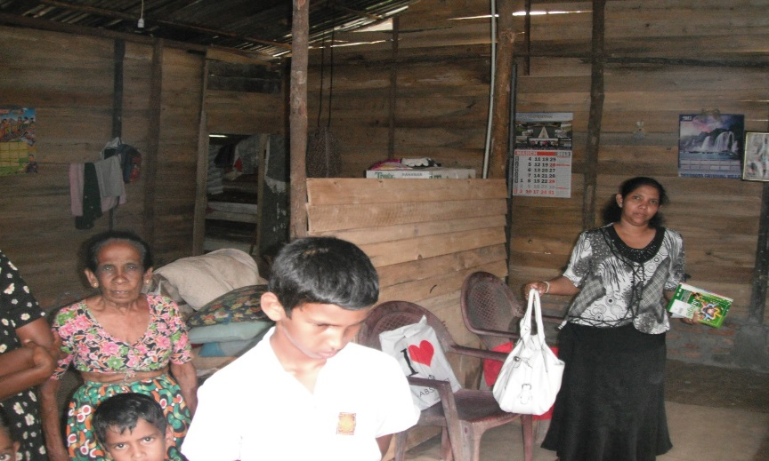
BE00026 Imran
Imran is 12 years old and he lives in Galgahaduwa, Wattala. He goes to Vidyaloka Maha Vidyalaya and is in grade 7. His studies are average.
His father met with an accident and was suffering for a long time. He takes treatment from a hospital but cannot afford to buy some medication from the pharmacy. However, he works from time to time as a handyman and earns about Rs5000 a month.
His mother Siththi worked as a labourer but not any more. She had her kidney removed due to a problem. The grand parents are also living at the same house with Imran’s siblings.
They had a temporary house but the local MP had given them money to build a house. So now they have a newly built house. They have used the money from the charity towards Imran’s education and the mother also tried to save up a bit for his future.
March 2013

Slide 6
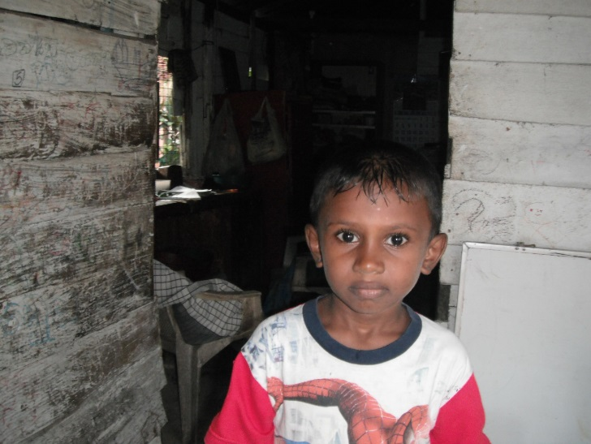
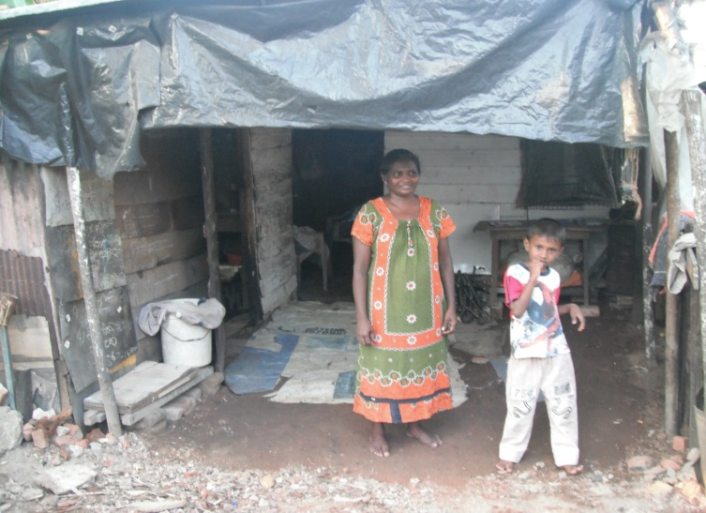
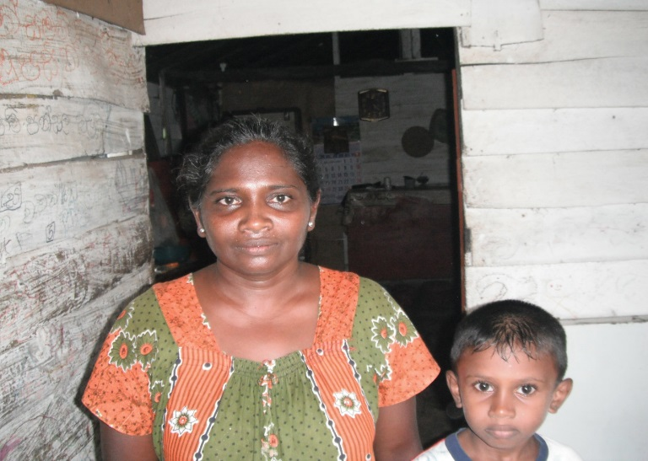
BE00027 Avindu
Avindu is 6 years old and lives in Galagahaduwa, Wattala. He goes to Vidyaloka Maha Vidyalaya and is now in grade 2. His studies are outstanding.
He has a sister who is in grade 3 and she is also good with studies.
Avindu’s father has met with an accident and has tubes inside his chest after an operation. He is unable to work now. He used to work at a garment factory.
His mother does sweeping at a house and earns about Rs2550 per month. She sometimes gets help from people she works for.
Their house is in a very poor state and hasn’t got much. They keep Avidu’s books inside an old fridge.
With the monthly grants he gets from the charity, the mother has been using it for food for Avindu and his sister. They have shoes and other school equipment too.
March 2013

Slide 7
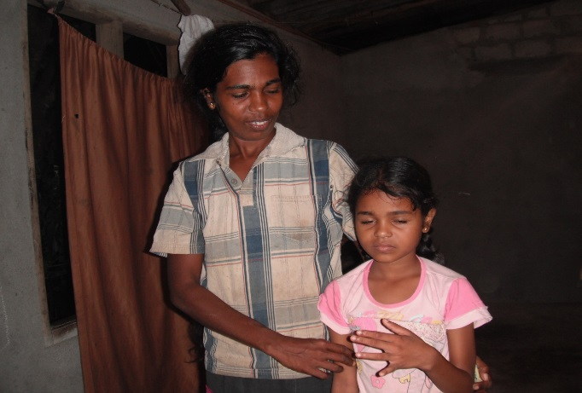
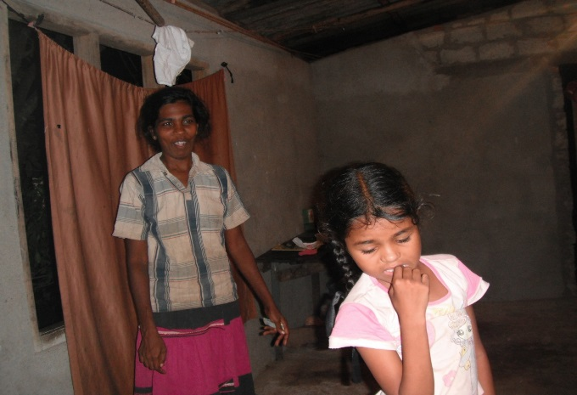
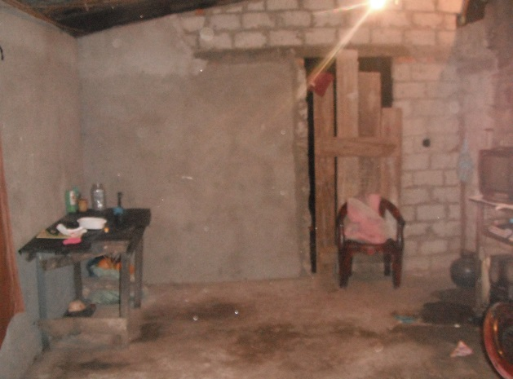
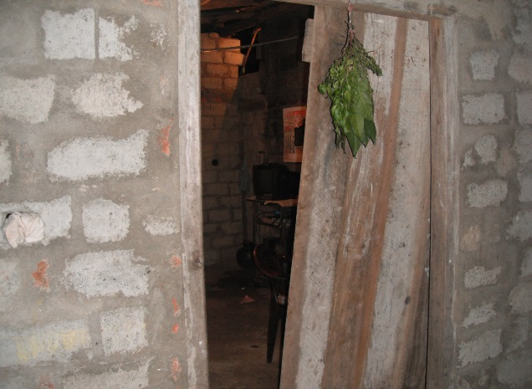
BE00028 Saumya
Saumya is 8 years old and lives in Awarakotuwa, Hendala. She goes to Vidyaloka maha Vidyalaya and is in grade 2. She is an outstanding student. She is good at singing, dancing and art.
She has four siblings. Her mother Kumudini doesn’t work. Her father Dayaratna works as a labourer but has a medical condition that restricts him from working full time.
We were unable to interview them as a child had measles and we couldn’t go in the house. We briefly saw her and took some photographs.
They barely had anything in the house. They are really in need of help as they are unable to cover their expenses.
March 2013

Slide 8
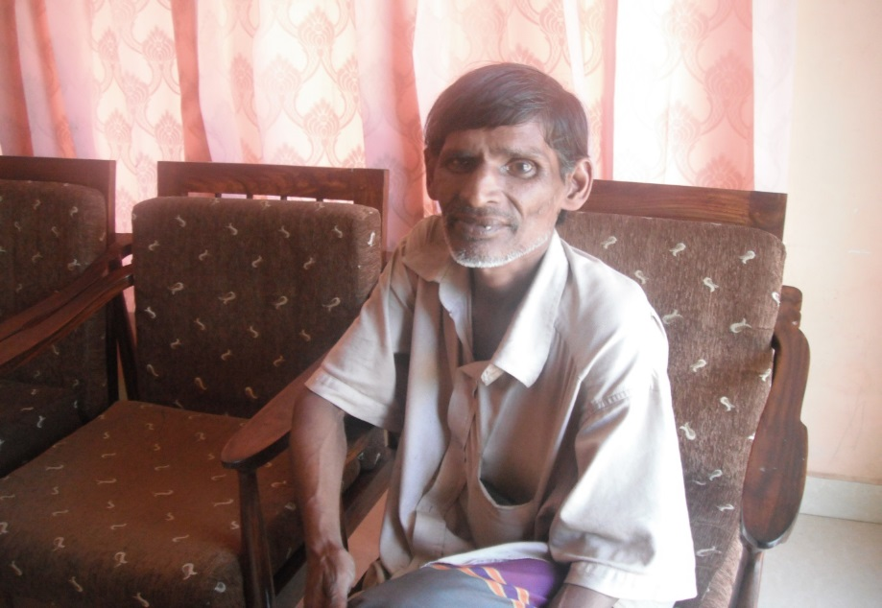
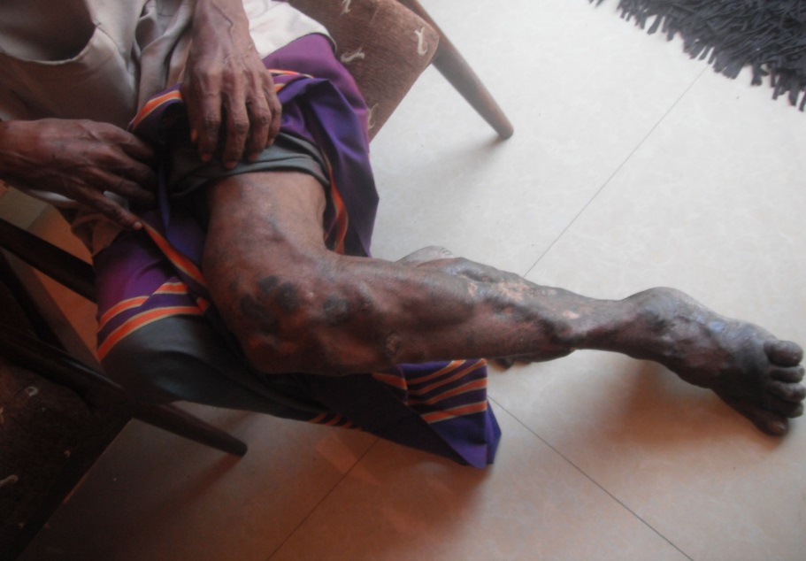
BE00029 J C Perera
J C Perera is 52 years old and lives in Kelaniya.
He met with an accident many years ago after a cement slab fell on it. He is unable to work. He needs an injection for this every month costing Rs1667.
He has two children and the son has got a growth in the brain that is being treatment at the National Hospital in Colombo.
His mother is also at home paralysed and needs a cannula costing Rs2000. His unmarried sister looks after her.
He came to visit us at the representative’s house and we saw the condition of his legs.
With the money he is getting from the charity, he has been taking regular injections and is feeling a lot better with the pain.
March 2013

Slide 9
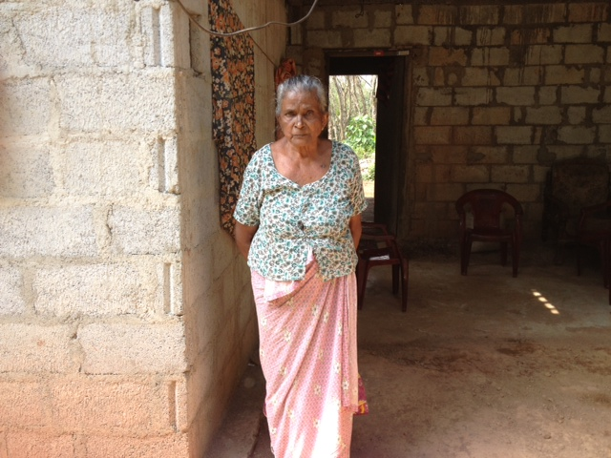
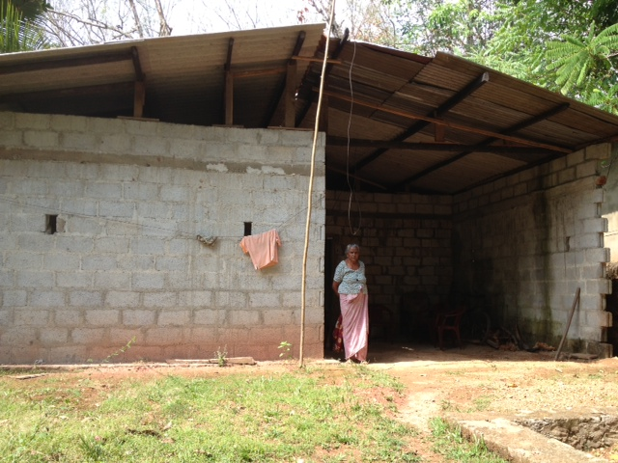
BE00030 Josinona
Josinona is 74 years old and lives in Homagama. She has severe asthma and needs to take regular medication. She is often in hospital too.
Her husband passed away many years ago and so did one of her sons who used to be a soldier. The government had built them the house they are living in now.
Her son Ajith looks after her. He drives a three wheeler belonging to someone else and earns money. Josinona has no income coming in but her son Ajith does what he could.
Her medication costs about Rs3000 monthly and with the charity’s help it will hopefully be a little bit easier. We took her on in February 2013.
March 2013

Slide 10
BE00031 Yashodhara
Yashodara is 13 years old and lives in Simyambala-anduwa, Monaragala.
Her story was published in the Diwaina national newspaper (12 Feb 2013) and one of our donor’s thought we could to help her out.
Yashodara goes to Mahakaugolla Junior School and is an outstanding student. She has won many awards for Sinahala language and literature conducted nationally. She is
They live in a very rural area and walks miles to attend school every day. She has 2 older brothers and a younger sister. Her mother Ranmanika doesn’t work. She had thyroid cancer and had treatments and needs to travel to Badulla for treatments.
Her father Jayasekara works as a farmer. He has hernia problems and has had operations for it. He has no permanent job and struggles to keep up with the family expenses. The weather is also not kind to them for farming in the area so has to live with the money they earn during the rainy seasons. The monthly expenditure is about Rs8000.
We took her on in March 2013 and will get a progress report in a few months.
March 2013

